Slide 1
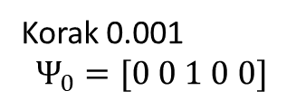
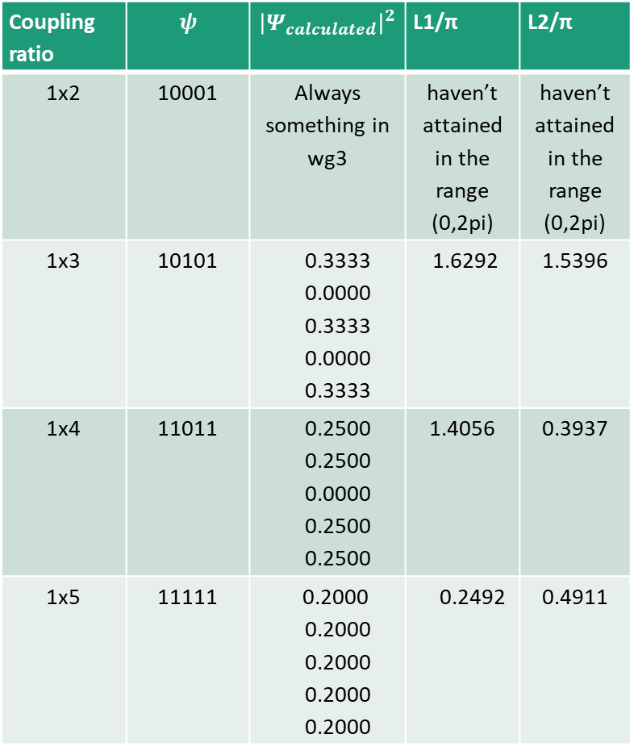
Coupling ratio | $$ψ$$ | $${\left|Ψ_{calculated}\right|}^{2}$$ | L1/π | L2/π
1x2 | 10001 | Always something in wg3 | haven’t attained in the range (0,2pi) | haven’t attained in the range (0,2pi)
1x3 | 10101 | 0.3333 0.0000 0.3333 0.0000 0.3333 | 1.6292 | 1.5396
1x4 | 11011 | 0.2500 0.2500 0.0000 0.2500 0.2500 | 1.4056 | 0.3937
1x5 | 11111 | 0.2000 0.2000 0.2000 0.2000 0.2000 | 0.2492 | 0.4911
Korak 0.001
$$Ψ_{0}=[0 0 1 0 0]$$
L2
L1

Slide 2
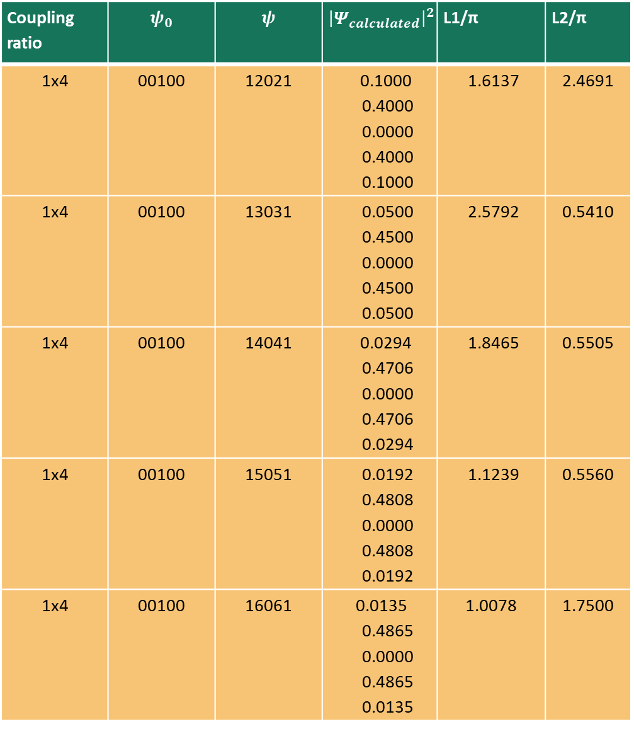
Coupling ratio | $$ψ_{0}$$ | $$ψ$$ | $${\left|Ψ_{calculated}\right|}^{2}$$ | L1/π | L2/π
1x4 | 00100 | 12021 | 0.1000 0.4000 0.0000 0.4000 0.1000 | 1.6137 | 2.4691
1x4 | 00100 | 13031 | 0.0500 0.4500 0.0000 0.4500 0.0500 | 2.5792 | 0.5410
1x4 | 00100 | 14041 | 0.0294 0.4706 0.0000 0.4706 0.0294 | 1.8465 | 0.5505
1x4 | 00100 | 15051 | 0.0192 0.4808 0.0000 0.4808 0.0192 | 1.1239 | 0.5560
1x4 | 00100 | 16061 | 0.0135 0.4865 0.0000 0.4865 0.0135 | 1.0078 | 1.7500
1x4 | 00100 | 17071 | 0.0100 0.4900 0.0000 0.4900 0.0100 | 1.7225 | 1.2002
1x4 | 00100 | 18081 | 0.0077 0.4923 0.0000 0.4923 0.0077 | 1.7281 | 0.5907
1x4 | 00100 | 19091 | 0.0061 0.4939 0.0000 0.4939 0.0061 | 1.8030 | 1.1193
1x4 | 00100 | 1 10 0 10 1 | 0.0050 0.4950 0.0000 0.4950 0.0050 | 1.7996 | 1.7214
1x4 | 00100 | 1 11 0 11 1 | 0.0041 0.4959 0.0000 0.4959 0.0041 | 1.7967 | 1.7224

Slide 3
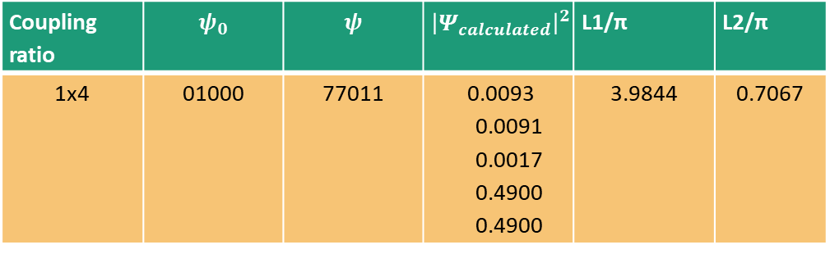
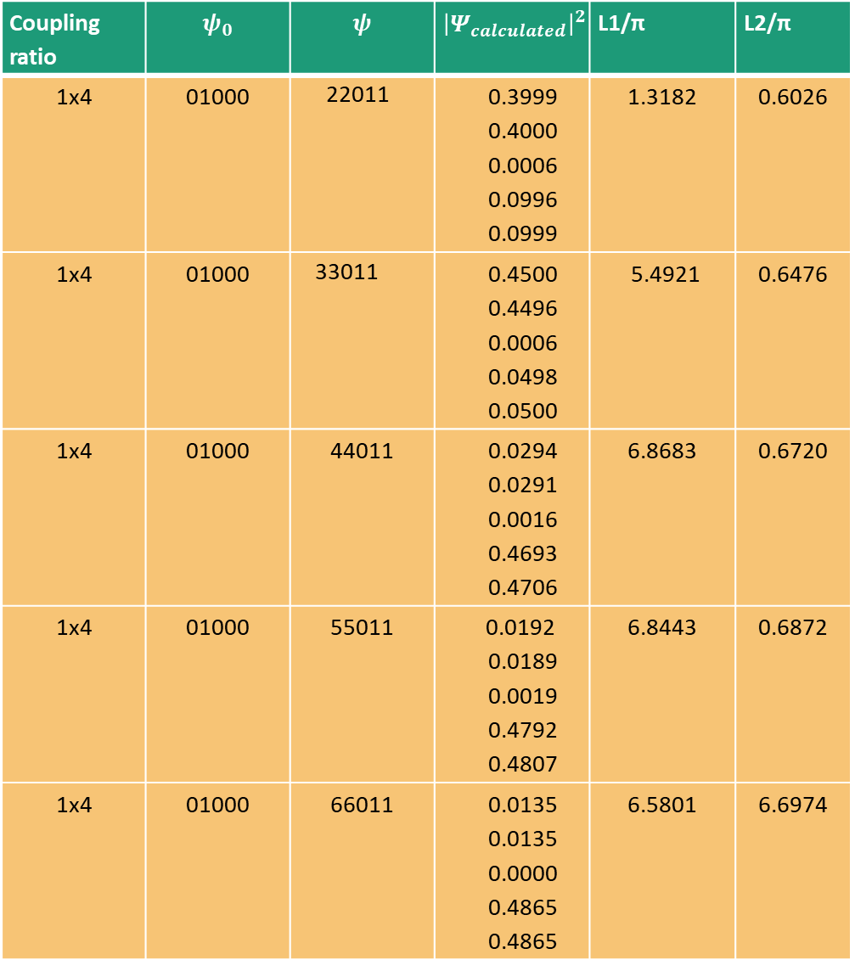
Coupling ratio | $$ψ_{0}$$ | $$ψ$$ | $${\left|Ψ_{calculated}\right|}^{2}$$ | L1/π | L2/π
1x4 | 01000 | 22011 | 0.3999 0.4000 0.0006 0.0996 0.0999 | 1.3182 | 0.6026
1x4 | 01000 | 33011 | 0.4500 0.4496 0.0006 0.0498 0.0500 | 5.4921 | 0.6476
1x4 | 01000 | 44011 | 0.0294 0.0291 0.0016 0.4693 0.4706 | 6.8683 | 0.6720
1x4 | 01000 | 55011 | 0.0192 0.0189 0.0019 0.4792 0.4807 | 6.8443 | 0.6872
1x4 | 01000 | 66011 | 0.0135 0.0135 0.0000 0.4865 0.4865 | 6.5801 | 6.6974
Coupling ratio | $$ψ_{0}$$ | $$ψ$$ | $${\left|Ψ_{calculated}\right|}^{2}$$ | L1/π | L2/π
1x4 | 01000 | 77011 | 0.0093 0.0091 0.0017 0.4900 0.4900 | 3.9844 | 0.7067
Korak 0.01

Slide 4
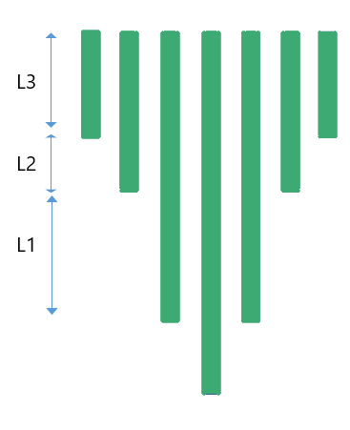
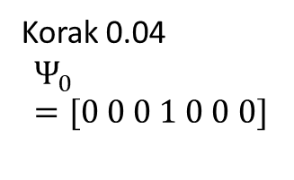
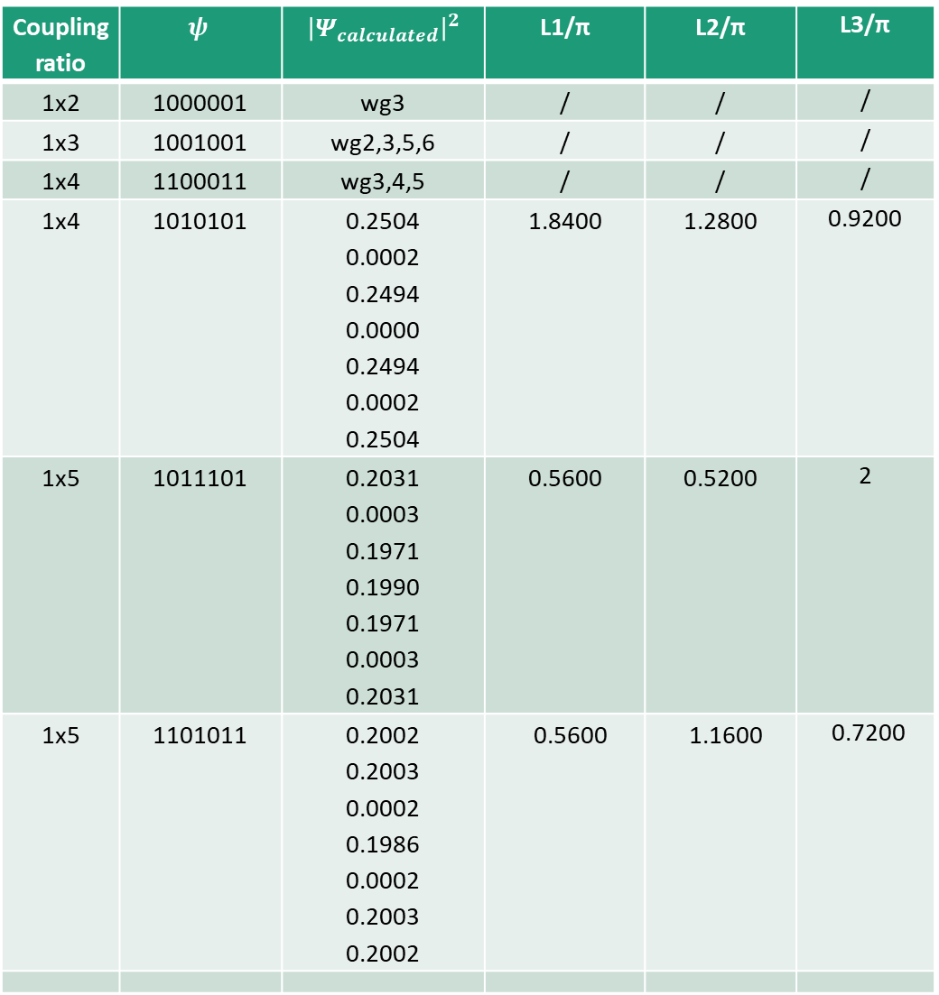
Coupling ratio | $$ψ$$ | $${\left|Ψ_{calculated}\right|}^{2}$$ | L1/π | L2/π | L3/π
1x2 | 1000001 | wg3 | / | / | /
1x3 | 1001001 | wg2,3,5,6 | / | / | /
1x4 | 1100011 | wg3,4,5 | / | / | /
1x4 | 1010101 | 0.2504 0.0002 0.2494 0.0000 0.2494 0.0002 0.2504 | 1.8400 | 1.2800 | 0.9200
1x5 | 1011101 | 0.2031 0.0003 0.1971 0.1990 0.1971 0.0003 0.2031 | 0.5600 | 0.5200 | 2
1x5 | 1101011 | 0.2002 0.2003 0.0002 0.1986 0.0002 0.2003 0.2002 | 0.5600 | 1.1600 | 0.7200
Korak 0.04
$$Ψ_{0}=[0 0 0 1 0 0 0]$$
1x6 | 1110111 | 0.1687 0.1664 0.1642 0.0015 0.1642 0.1664 0.1687 | 0.8400 | 1.8000 | 1.2800
1x7 | 1111111 | 0.1326 0.1489 0.1431 0.1508 0.1431 0.1489 0.1326 | 0.3200 | 0.8000 | 0.7600

Slide 5
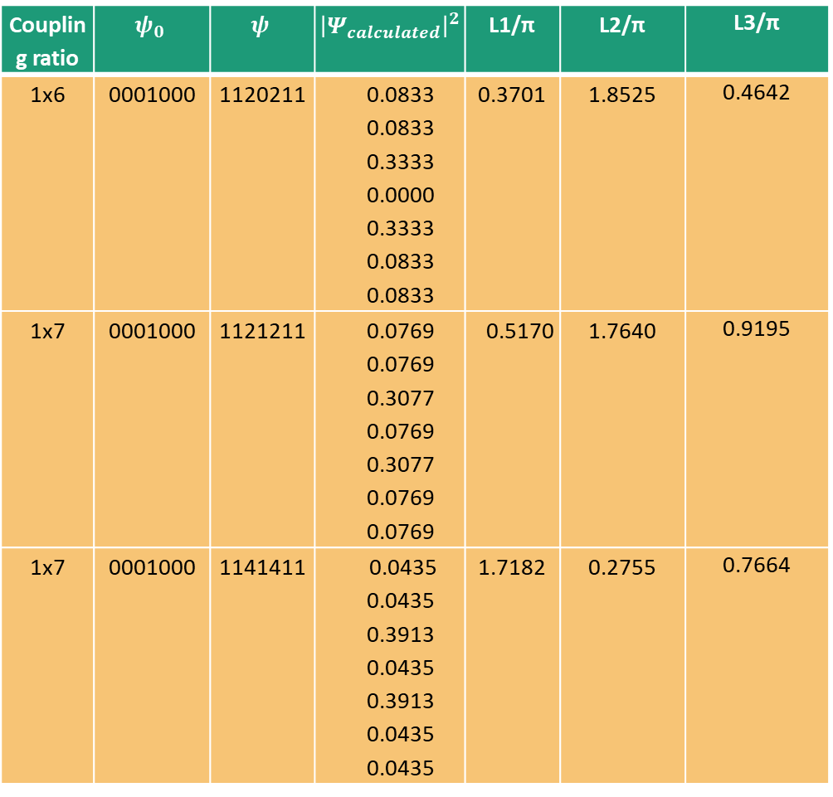
Coupling ratio | $$ψ_{0}$$ | $$ψ$$ | $${\left|Ψ_{calculated}\right|}^{2}$$ | L1/π | L2/π | L3/π
1x6 | 0001000 | 1120211 | 0.0833 0.0833 0.3333 0.0000 0.3333 0.0833 0.0833 | 0.3701 | 1.8525 | 0.4642
1x7 | 0001000 | 1121211 | 0.0769 0.0769 0.3077 0.0769 0.3077 0.0769 0.0769 | 0.5170 | 1.7640 | 0.9195
1x7 | 0001000 | 1141411 | 0.0435 0.0435 0.3913 0.0435 0.3913 0.0435 0.0435 | 1.7182 | 0.2755 | 0.7664
1x7 | 0001000 | 1151511 | 0.0182 0.0182 0.4546 0.0182 0.4546 0.0182 0.0182 | 1.1191 | 1.8832 | 1.3973
1x7 | 0001000 | 2340432 | 0.0690 0.1552 0.2759 0.0000 0.2759 0.1552 0.0690 | 1.8561 | 0.3057 | 1.2058
1x | 0001000 | 1234321 | 0.0227 0.0909 0.2046 0.3636 0.2046 0.0909 0.0227 | 0.2038 | 1.3132 | 1.7243
1x7 | 0001000 | 1112111 | 0.1000 0.1000 0.1000 0.4000 0.1000 0.1000 0.1000 | 0.1984 | 1.6394 | 1.1225

Slide 6
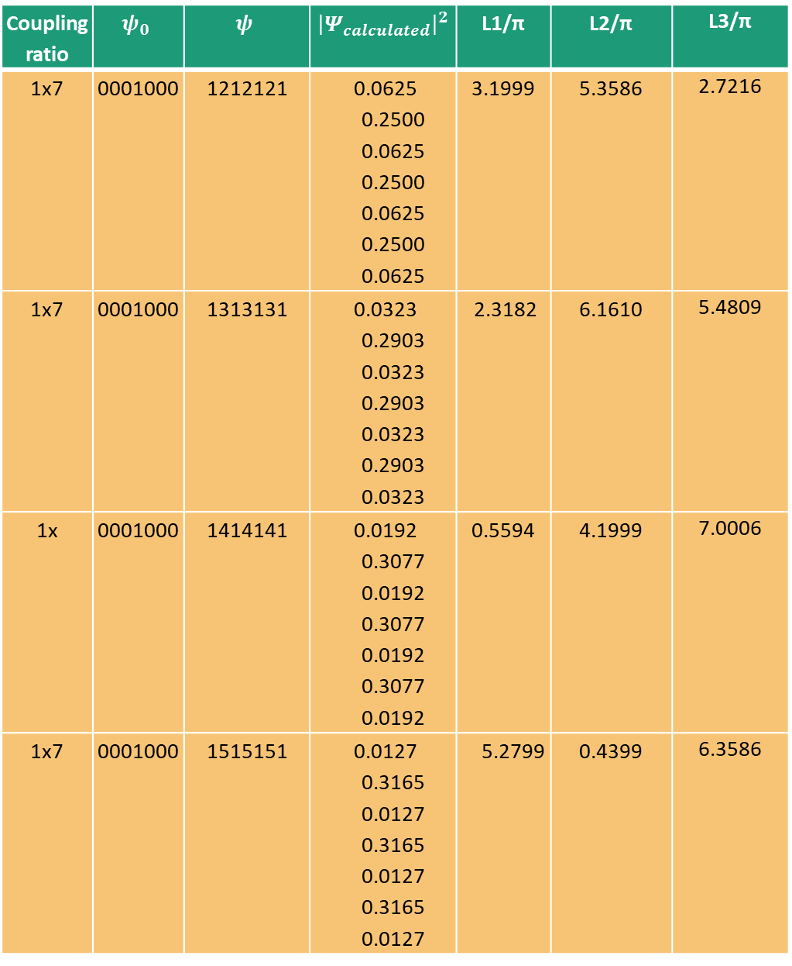
Coupling ratio | $$ψ_{0}$$ | $$ψ$$ | $${\left|Ψ_{calculated}\right|}^{2}$$ | L1/π | L2/π | L3/π
1x7 | 0001000 | 1212121 | 0.0625 0.2500 0.0625 0.2500 0.0625 0.2500 0.0625 | 3.1999 | 5.3586 | 2.7216
1x7 | 0001000 | 1313131 | 0.0323 0.2903 0.0323 0.2903 0.0323 0.2903 0.0323 | 2.3182 | 6.1610 | 5.4809
1x | 0001000 | 1414141 | 0.0192 0.3077 0.0192 0.3077 0.0192 0.3077 0.0192 | 0.5594 | 4.1999 | 7.0006
1x7 | 0001000 | 1515151 | 0.0127 0.3165 0.0127 0.3165 0.0127 0.3165 0.0127 | 5.2799 | 0.4399 | 6.3586

Slide 7
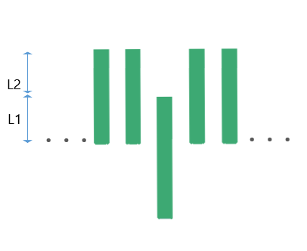

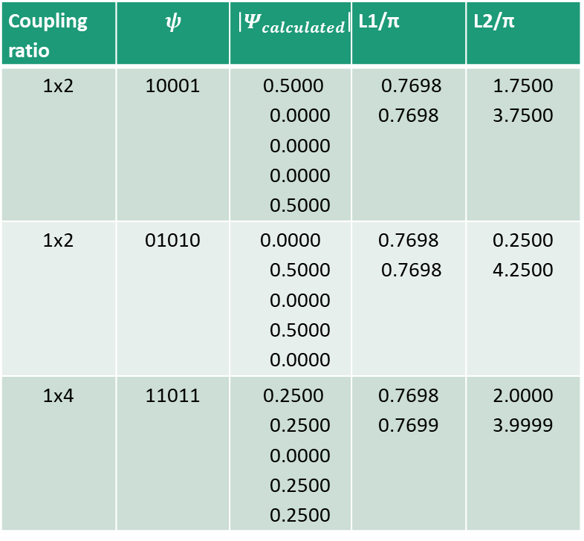
n=5
Coupling ratio | $$ψ$$ | $${\left|Ψ_{calculated}\right|}^{2}$$ | L1/π | L2/π
1x2 | 10001 | 0.5000 0.0000 0.0000 0.0000 0.5000 | 0.7698 0.7698 | 1.7500 3.7500
1x2 | 01010 | 0.0000 0.5000 0.0000 0.5000 0.0000 | 0.7698 0.7698 | 0.2500 4.2500
1x4 | 11011 | 0.2500 0.2500 0.0000 0.2500 0.2500 | 0.7698 0.7699 | 2.0000 3.9999
korak 0.01
$$Ψ_{0}=[0 0 1 0 0]$$

Slide 8
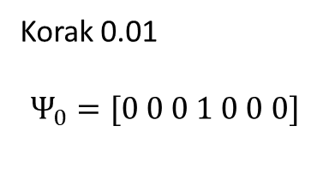
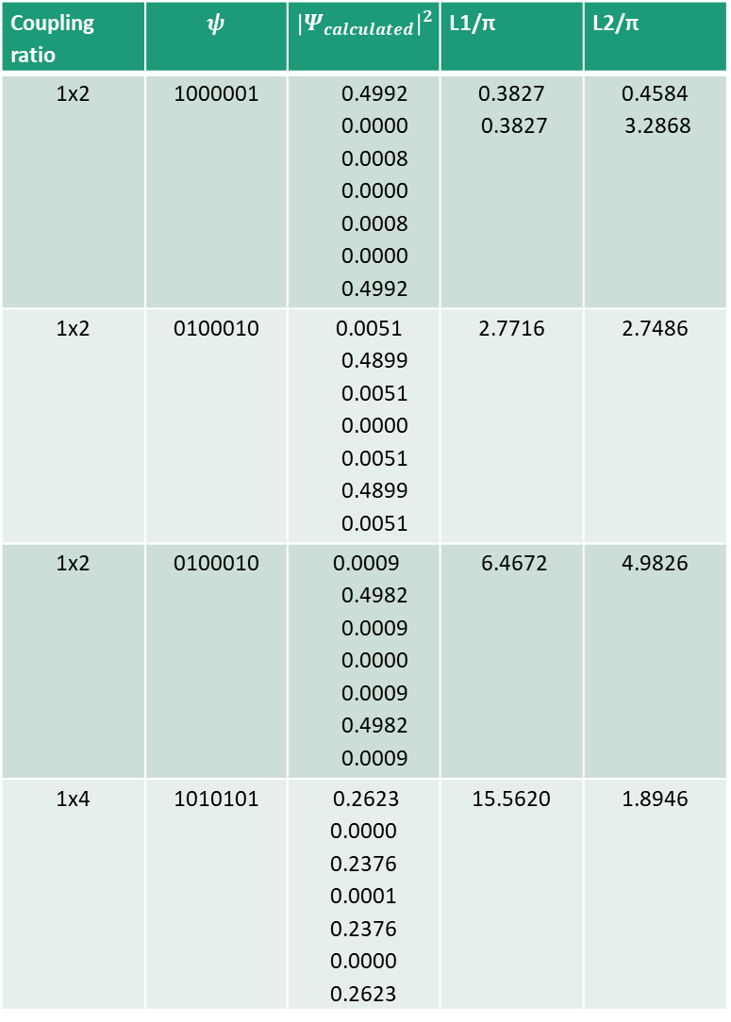
n=7
Coupling ratio | $$ψ$$ | $${\left|Ψ_{calculated}\right|}^{2}$$ | L1/π | L2/π
1x2 | 1000001 | 0.4992 0.0000 0.0008 0.0000 0.0008 0.0000 0.4992 | 0.3827 0.3827 | 0.4584 3.2868
1x2 | 0100010 | 0.0051 0.4899 0.0051 0.0000 0.0051 0.4899 0.0051 | 2.7716 | 2.7486
1x2 | 0100010 | 0.0009 0.4982 0.0009 0.0000 0.0009 0.4982 0.0009 | 6.4672 | 4.9826
1x4 | 1010101 | 0.2623 0.0000 0.2376 0.0001 0.2376 0.0000 0.2623 | 15.5620 | 1.8946
1x4 | 1100011 | 0.2460 0.2483 0.0056 0.0000 0.0056 0.2483 0.2460 | 8.0363 | 5.8527
1x4 | 0110110 | 0.0054 0.2495 0.2451 0.0000 0.2451 0.2495 0.0054 | 8.0363 | 4.1340
1x6 | 1110111 | 0.1665 0.1784 0.1550 0.0000 0.1550 0.1784 0.1665 | 12.6285 | 9.7613
1x6 | 1110111 | 0.1702 0.1593 0.1705 0.0000 0.1705 0.1593 0.1702 | 18.7515 | 14.2886
Korak 0.01
$$Ψ_{0}=[0 0 0 1 0 0 0]$$

Slide 9
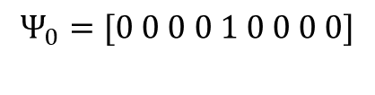
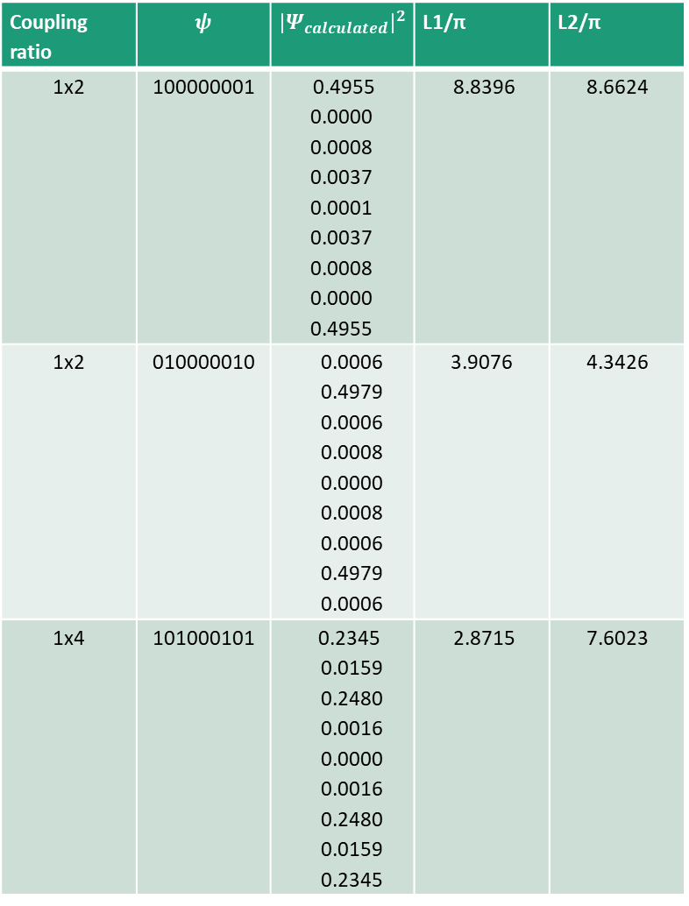
n=9
Coupling ratio | $$ψ$$ | $${\left|Ψ_{calculated}\right|}^{2}$$ | L1/π | L2/π
1x2 | 100000001 | 0.4955 0.0000 0.0008 0.0037 0.0001 0.0037 0.0008 0.0000 0.4955 | 8.8396 | 8.6624
1x2 | 010000010 | 0.0006 0.4979 0.0006 0.0008 0.0000 0.0008 0.0006 0.4979 0.0006 | 3.9076 | 4.3426
1x4 | 101000101 | 0.2345 0.0159 0.2480 0.0016 0.0000 0.0016 0.2480 0.0159 0.2345 | 2.8715 | 7.6023
1x4 | 110000011 | 0.2452 0.2540 0.0002 0.0006 0.0000 0.0006 0.0002 0.2540 0.2452 | 4.7972 | 7.2353
1x4 | 011000110 | 0.0001 0.2503 0.2473 0.0024 0.0000 0.0024 0.2473 0.2503 0.0001 | 3.9075 | 7.8923
1x6 | 111000111 | 0.1657 0.1617 0.1707 0.0019 0.0001 0.0019 0.1707 0.1617 0.1657 | 0.3827 | 7.2447
1x8 | 111101111 | 0.1213 0.1286 0.1241 0.1260 0.0000 0.1260 0.1241 0.1286 0.1213 | 4.7971 | 5.0006
$$Ψ_{0}=[0 0 0 0 1 0 0 0 0]$$

